Slide 1
E-COMMERCE ROLES
FOR GLOBAL BUSINESS EXPANSION
August, 2015
Mr. Tran Dinh Toan – Deputy CEO – toantd@osbholding.com

Slide 2
CONTENT
1
OSB Overview
2
Vietnam Export Outlook
3
E-commerce Roles
4
Alibaba.com model

Slide 3
OSB Investment and Technology JSC
Establishment day 3 / 8 / 2007
Head Office
Rep. Office
Rep. Office
Reseller
O
ppotunity
Employeers
Hanoi
Ho Chi Minh
City
Vung Tau
City
Da Nang
City
        INTRODUCE
100+
S
olution
Can Tho
City
B
usiness
        Satellite & Telecom
Room 305, DETECH Building,
No. 8 Ton That Thuyet Str,
My Dinh, Nam Tu Liem Hanoi
Providing equipment | Consultancy
Technical services | HR Development
Tel: +84 4 36.40.40.69
Fax: +84 4 36.40.36.69
        Information Technology
        3 MAIN ACTIVITIES
        CONTACT US
Web application | Web 2.0
e-Commerce website | e-Government
contact@osbholding.com
        e-Commerce
Authorized Reseller of Alibaba Group from 2009
www.osbholding.com

Slide 4
Potential of Vietnam Export and Import 2005-2014
Billion USD
Source: Vietnam Customs 15/2/2014

Slide 5
Top Vietnamese Export Product in 2014
Source: Vietnam Customs 15/2/2014

Slide 6
Top Vietnam Export Market in 2014
Source: Vietnam Customs 15/2/2014

Slide 7
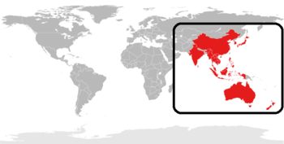
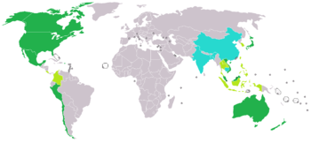
Vietnam globalization and market openness
Vietnam now is under a lot of FTA negotiation with various large partner simultaneously
such as TPP, EU.
FTAs have been signed
AFTA
Asean
AIFTA
Asean - India
AANZFTA
Asean – Australia/New Zealand
AKFTA
Asean – Korea
AJCEP
Asean – Japan
ACFTA
Asean – China
VCFTA
Vietnam – Chile
EPA
Vietnam – Japan
VCUFTA
Vietnam – Belarus – Kazakhstan – Russia
FTAs are under negotiation or just completed negotiation
RCEP
Regional Comprehensive Economic Partnership
TPP
Trans-Pacific Partnership
ASEAN + 6
(ASEAN, China, Japan, Korea, India, Australia, New Zealand)
Brunei, Chile, New Zealand, Singapore, USA, Australia, Peru, Malaysia, Mexico, Canada, Japan, Taiwan, Korea, Vietnam
TREATI
Asean – EU
EVFTA
Vietnam – EU
VEFTA
Vietnam – Switzerland – Norway – Liechtenstein – Iceland

Slide 8
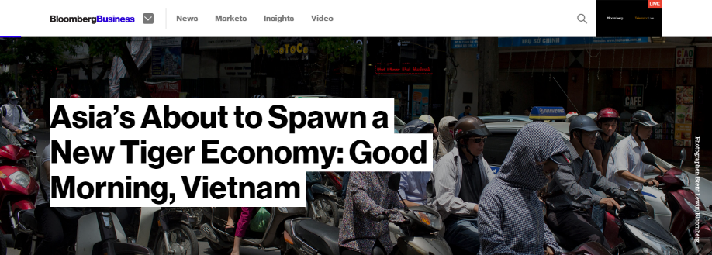
Great opportunity ahead!
“The country has the potential to become
one of the world’s fastest-growing economies
over the period to 2050,
According to PricewaterhouseCoopers LLP”

Slide 9

www.osbholding.com
People now being connected!
Leads to the changes of purchasing behavior!

Slide 10

Internet of Things

Slide 11
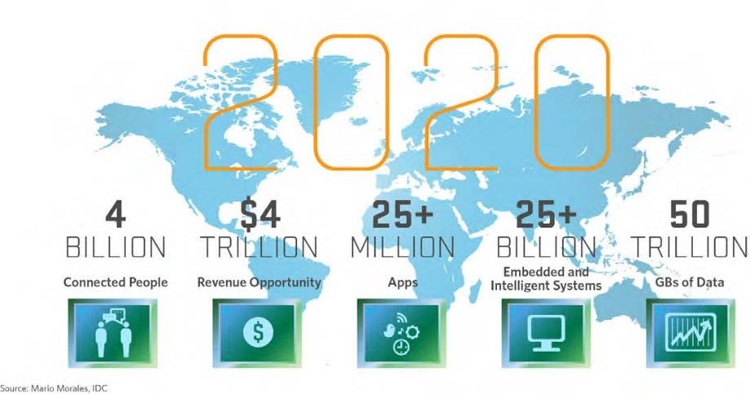
Internet of Things
”The Internet Of Things” will be Huge,
and drive tremendous Value
for People and Businesses!

Slide 12
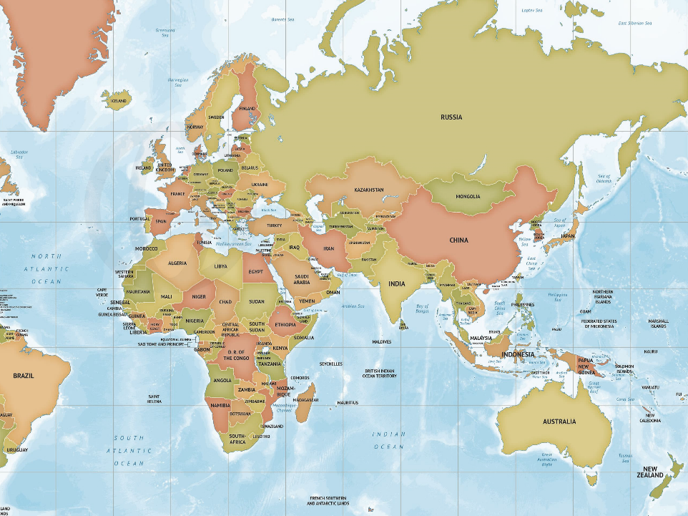
… to a “Global” Sourcing Network
www.osbholding.com
Bulgaria
Poland
Moldova
Croatia
Romania
Turkmenistan
China
Turkey
Bangladesh
Morocco
Israel
Egypt
India
Vietnam
Cambodia
Sri Lanca
Indonesia
Source: TESCO

Slide 13
Online Trending
Online
Channels
Offline
Channels
81%
Percentage of enterprises seeking buyers & sellers online
Traditional
Channels
Source: Nielsen Company
71%
Percentage of enterprises want to join international trading compared with 2014

Slide 14
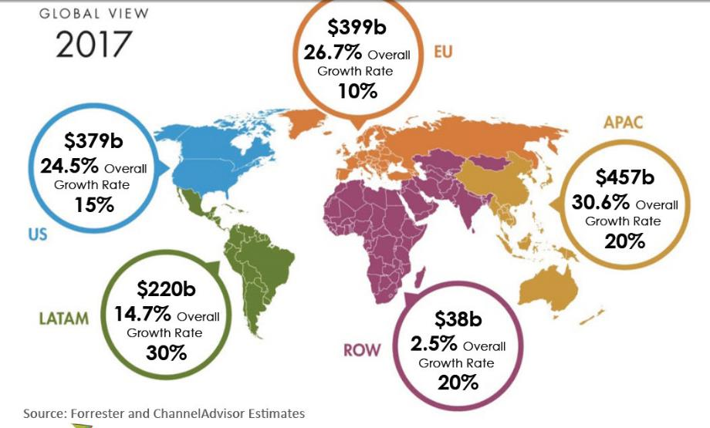
Global E Commerce growth by region

Slide 15
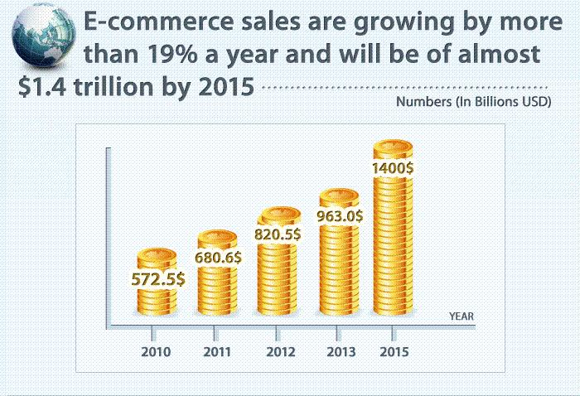
E Commerce growth by 2015

Slide 16
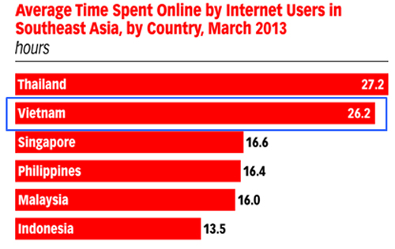
Vietnam E-Commerce
Internet: 39%, ranking No 1 in ASEAN (T1/2014, We are Social and comScore)
Cell phone: 151% (June, 2013)
3G: 37% (Sep, 2013)
Population of VN 2014 | Population using the Internet | Estimated value of online purchases of each person in 2014 | Percentage of Internet access participating in online shopping | Estimated revenues from B2C in 2014
90.73 million | 39% | 145 USD | 58% | 2.97 billion
Source: Vietnam E-Commerce Report 2014, VECITA

Slide 17

www.osbholding.com
E-Commerce is a KEY strategy
for the global business EXPANSION

Slide 18

www.osbholding.com
OVERVIEW
Established since 1999
By 12/2013 Alibaba.com has 43.8 million Members from 240 countries
90% members wishing to buy, that mean Alibaba has nearly 40 million Buyers
Average member growth 80% per years
Alibaba has 40+ Industries and 5,900+ Product Categories
Alibaba has 5.5 million online stores

Slide 19

Alibaba Global User Base
www.osbholding.com
Canada
2.0+
million
Russia
2.3+
million
U.K.
1.9+
million
Germany
609+
thousand
Australia
1.3+
million
U.S.
9.6+
million
Turkey
647+
thousand
Brazil
2.1+
million
Malaysia
909+
thousand
Data as of December 31, 2013

Slide 20
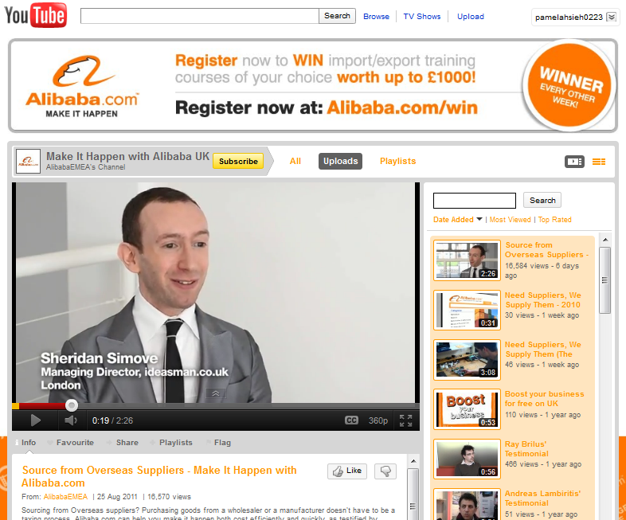
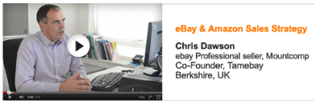
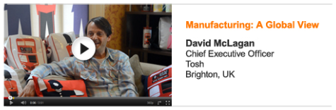
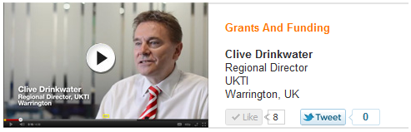
How Alibaba attract buyer to the platform?
Step 1
Buyer training
Step 2
Buyer Sourcing Event
Step 3
RFQs
Step 4
Global Tradeshow
Global buyer share their experiences via Alibaba training videos. It is aimed at providing global buyer the guide to source products on Alibaba.com effectively.
More than 2 million buyer all around the world have been trained so far and highly appreciate such training.

Slide 21

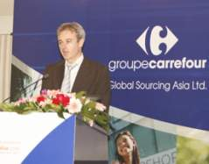
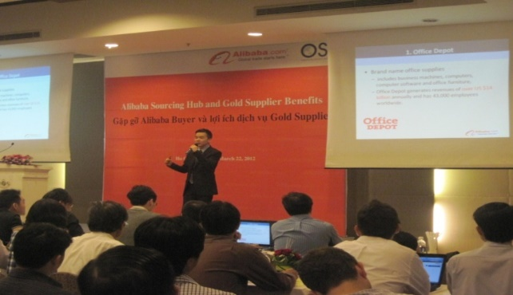
How Alibaba attract buyer to the platform?
Step 1
Buyer training
Step 2
Buyer Sourcing Event
Step 3
RFQs
Step 4
Global Tradeshow
The Buyer Sourcing online or offline will bring the attractive business opportunity for Gold Supplier where they can meet global big buyers
Buyer Sourcing will reduce risk of global product sourcing for big buyer and give more choices with quality suppliers in a short time.
KCX
international

Slide 22
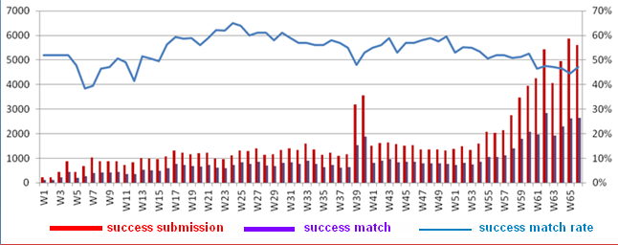
How Alibaba attract buyer to the platform?
Step 1
Buyer training
Step 2
Buyer Sourcing Event
Step 3
RFQs
Step 4
Global Tradeshow
Identify potential buyer thru RFQs
RFQs (Request For Quotations) This is quality inquiry filter, Industry specialist from Alibaba.com will randomly and send to Alibaba.com member
5000 effective quotations from GGS every day on average but 30% of RFQ have not received RFQ in the first week!
20,000 new RFQ upload on daily basic on the Alibaba.com
Increased 120,000
RFQs every week
Rate of successful order from RFQ is 6 times higher than normal inquiry

Slide 23
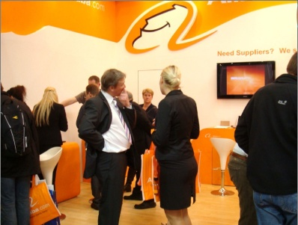
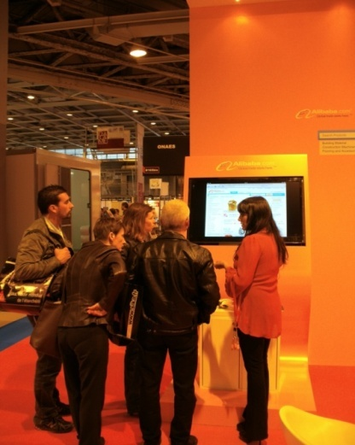
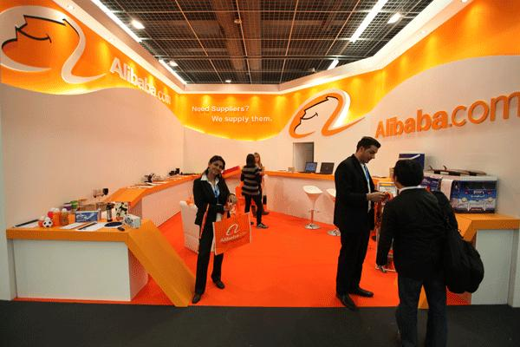
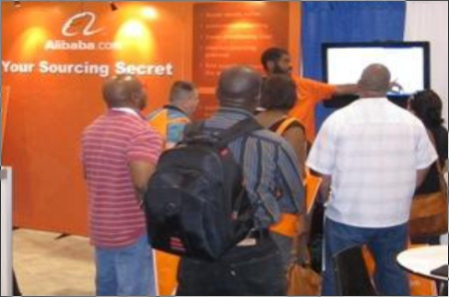
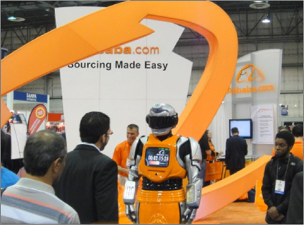
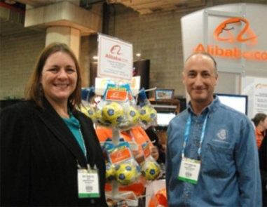
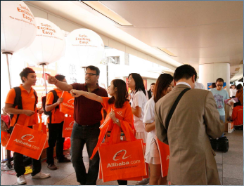
How Alibaba attract buyer to the platform?
Step 1
Buyer training
Step 2
Buyer Sourcing Event
Step 3
RFQs
Step 4
Global Tradeshow
Alibaba.com has been actively promoting its brand name and Gold Supplier members at a lot of leading international tradeshows around the world.
Europe
Asia
Hannover Messe, Germany
Paris, Batimat
Frankfort Ambiente
Asian American
America
Las Vegas, SEMA
Las Vegas, CES
New York
Hong Kong

Slide 24
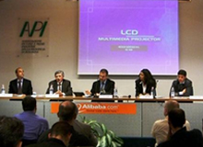
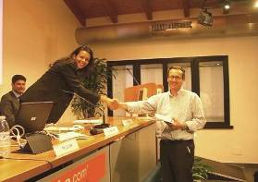
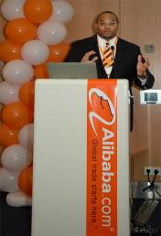
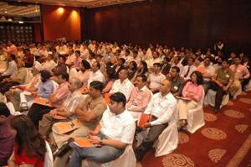
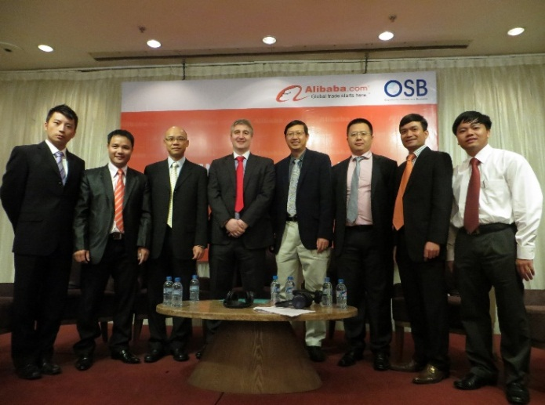
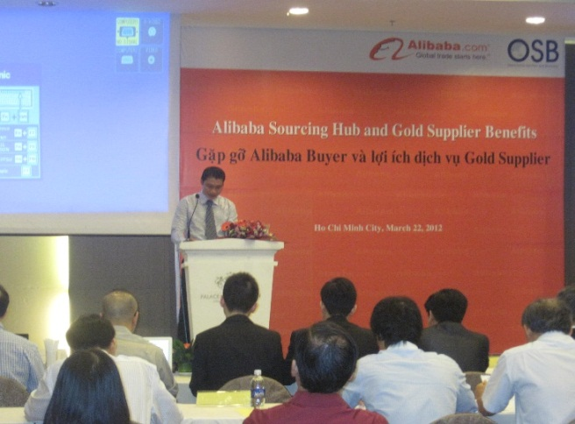
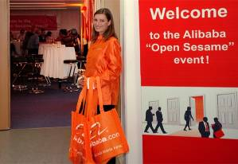
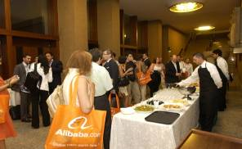
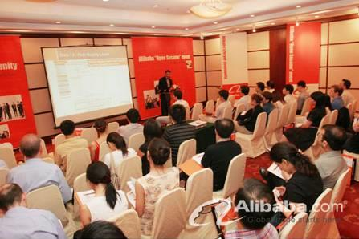
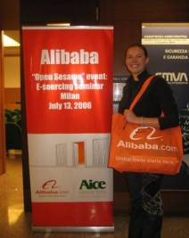
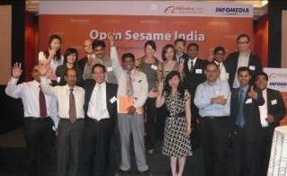
Buyers’ Best Friends
Notes:
24
SME Buyers’ Best Friends: Open Sesame

Slide 25

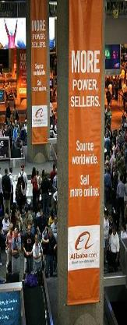














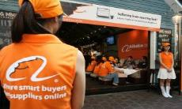
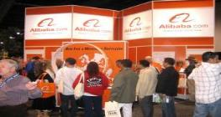

Global Trade Show Promotion
Alibaba.com participates in over 35 leading international trade shows per year to help our Gold Supplier members promote their products.

Slide 26
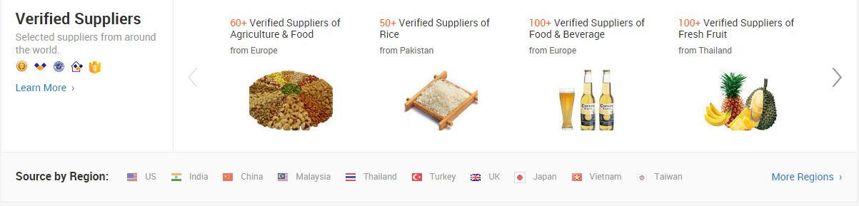
Vietnamese Member on Alibaba.com
300,000
members
1999
2000
2001
2002
2003
2004
2005
2006
2007
2008
2009
2010
2011
2012
2013
2014
2015
FIRST
Vietnam Member
100,000
members
200,000
members
143%
136%

Slide 27
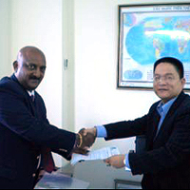
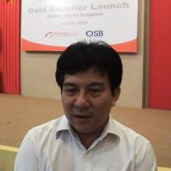


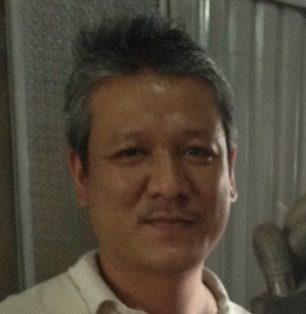





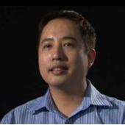





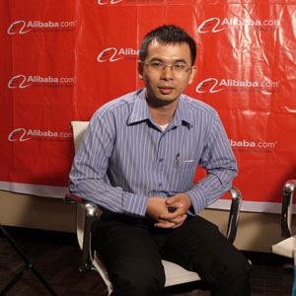
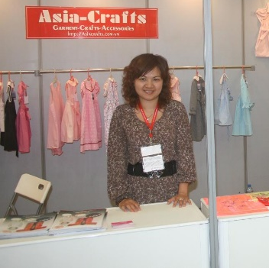

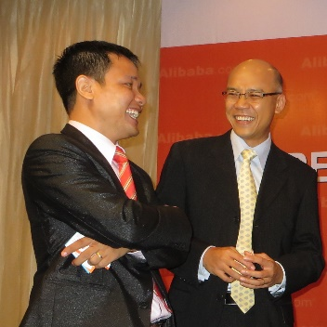
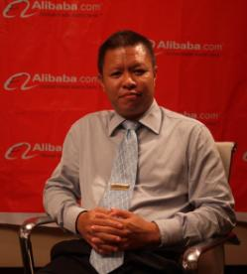
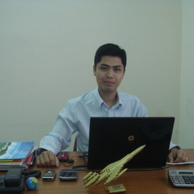

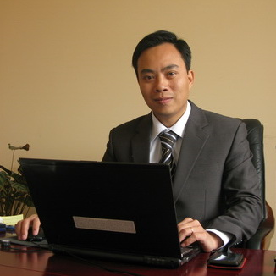
VIETNAMESE SUCCESS STORIES
http://osb.alibaba.com

